Slide 1
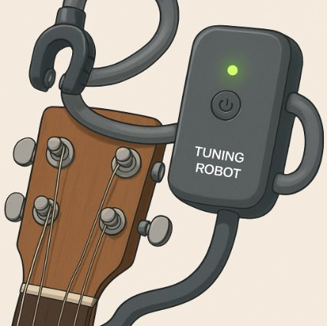
Mid-Term Design Review -Tuning Robot
Group:Beyond
Member:
Ma Chibin 1009673
JIao Jiajun 1009743
https://github.com/RuaMaCB/Tuner-Robot.git

Slide 2
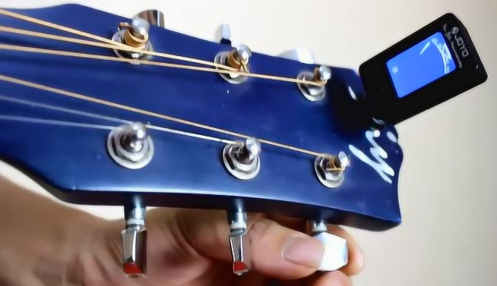
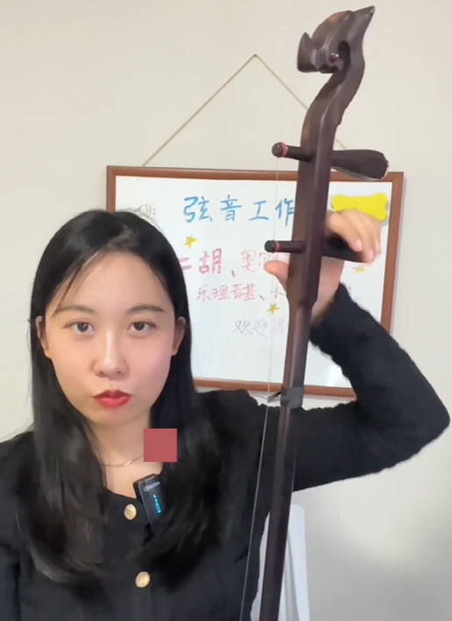
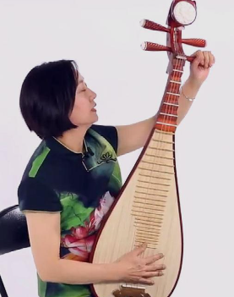
Introduction
Background & Motivation
Most commercial tuners and auto-tuning devices (Roadie3) target Western multi-string instruments like guitar, ukulele, and bass
However, traditional Chinese string instruments (e.g., erhu, pipa, guzheng) have different tuning pegs, structure, and tuning behavior

Slide 3
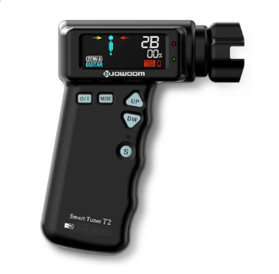
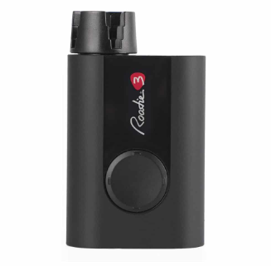
Introduction State of the art & Literature Review
FretSync Smart Automatic Guitar Tuner
Rodie 3 Tuner
Fast and efficient tuning
Easy-to-read color display

Slide 4

Problem Statement
Pitch detection(How to choose and use sensors)
Universal Mechanical Adaptability(Design of the soft gripper)
Flexible Transmission Integration(Combination of the motor and gripper)

Slide 5
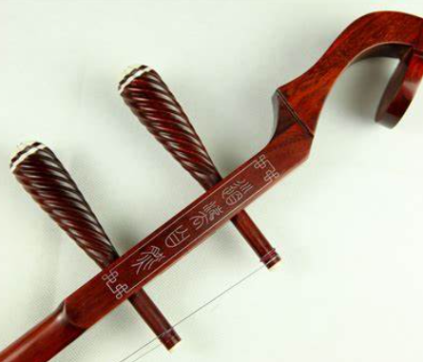
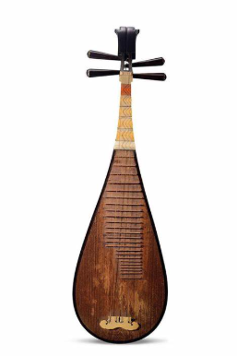
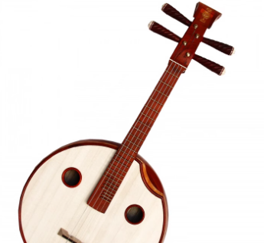
Problem Statement Project objectives & Goals
Design a tuner for different kinds of Chinese string instruments.

Slide 6
Proposed Approach Design thinking process & Methodology
Empathize | Identify user pain points in tuning Chinese instruments
Define | Frame the problem: lack of universal tuning tools
Ideate | Propose soft gripper + flexible shaft + pitch sensing
Prototype | Build Arduino-based prototype with servo + mic
Test | Test on ukelele/erhu; refine grip & control logic

Slide 7
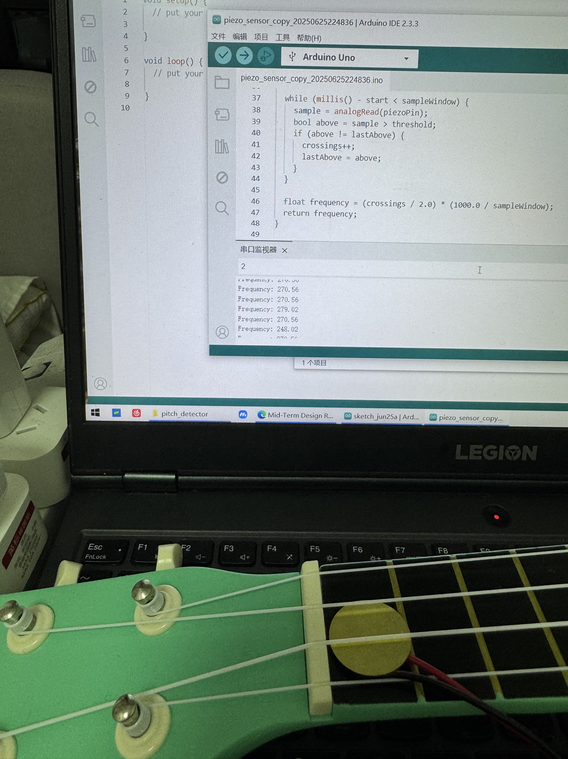
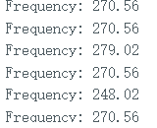
Proposed Approach Design thinking process & Methodology
Using microphone or other sensor to detect the pitch.
Insensitive and inaccurate
Piezo sensor
Piezo sensor testing

Slide 8
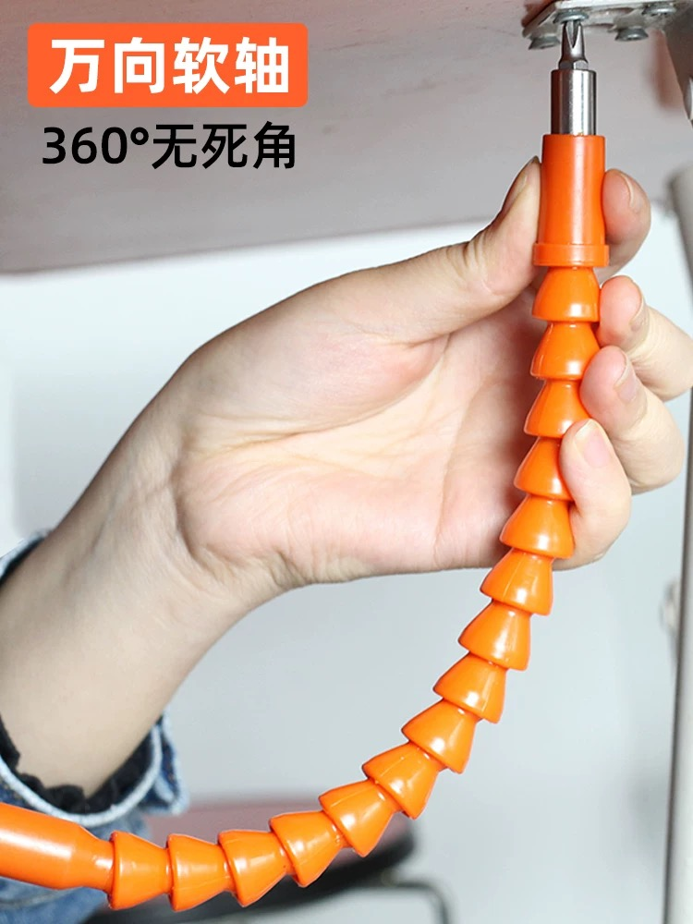
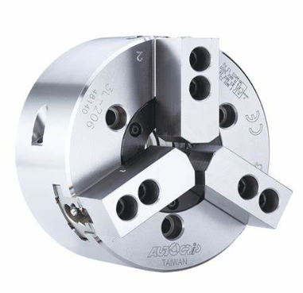
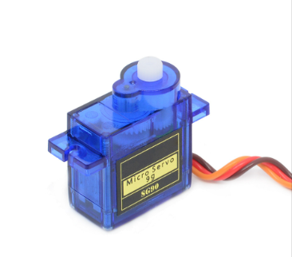
Proposed Approach Design thinking process & Methodology
Using convert to combine the motor and soft gripper.
Soft Gripper
Motor
Link

Slide 9
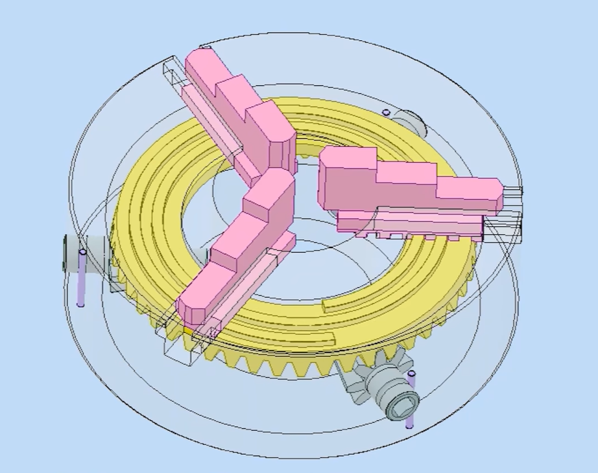
Soft gripper design
Improve on the three-jaw truck
Use the soft material to replace the jaws

Slide 10
Timeline
Week 6-7 | Waiting for the material and recess
Week 8 | Tesiting the microphone and pitch detection module
Week 9 | Design the soft gripper and combination module
Week 10 | Print or buy all the parts and assemble.
Week 11 | Combine the motor and the gripper,begin final test
Week 12 | Organizing and preparing for the final presentation.
Week 13 | Final check and improve.Final Presentation.

Slide 11
Reference
Zhang, H. et al. （2022）. Reinforcement Learning-Based Adaptive Tuning. IEEE Instrumentation Magazine.
Kim, Y. et al. （2021）. Soft Gripper Design for Delicate Manipulation. Soft Robotics Journal.
Band Industries. Roadie 3 Auto Guitar Tuner. https://www.roadiemusic.com
Chu, L. et al. （2020）. Sensor-Based Auto Tuning Device. Sensors and Actuators A.
Yang, M. et al. （2019）. Low-power Real-time Pitch Detection. Journal of Signal Processing Systems.

Slide 12


Thank you!

